Slide 1

EMB-101: Emergence of Bangladesh Lecture-5
British India: 1912-1947

Slide 2
Khilafat and Non-cooperation Movement
Rowlatt Act and Jalianwallah Bagh massacre sparked Satyagraha
Dismemberment of Ottoman Empire by British angered Muslims; Khilafat movement
Gandhi supported Khilafat cause to enlist Muslim support
Gandhi linked issues of of Swaraj (Self-Government) with the Khilafat demands at Nagpur Congress Session (1920)
Non-cooperation plan adopted at the session which aimed to resist British occupation
Strategies of the movement;
Boycott govt., education, court, cloth and election
Establish national institutions
End of Non-cooperation
Chauri Chaura incident
Gandhi called off the movement

Slide 3
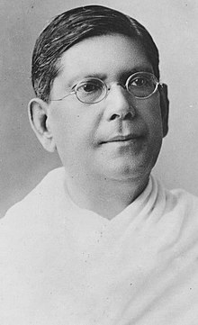
Hindu-Muslim Unity
The Pact was discarded in the Provincial Congress Conference
Bengal Pact, 1924
Agreement aimed to resolve Hindu-Muslim differences
To strengthen relations
Representation on population basis with separate electorates.
Local bodies’ representation; majority 60% and minority 40%.
Govt. appointments; 55% for Muslims. Till it is attained, Muslims 80% and Hindus 20%.
No resolution or enactment without consent of 75% of elected members of the affected community.
Music not allowed in front of the mosques.
No legislation in respect of cow slaughtering for food the Council.
Deshbondhu
Chittaranjan Das

Slide 4
Government of India Act 1935
Simon Commission report was boycotted
Features of the Act
Abolition of diarchy at province, introduction at centre.
Indian Council replaced by an advisory body.
All India Federation with British India territories and princely states.
Safeguards and protective instruments for minorities.
Supremacy of British Parliament.
Increase in size of legislatures, extension of franchise, division of subjects into three lists and retention of communal electorate.
Separation of Burma from India
Communal award 1932; Congress and other parties had reservations
The Government of India Act, 1935 passed in the Parliament
Responsible govt. with adult franchise
General election was held in 1937 under this Act

Slide 5
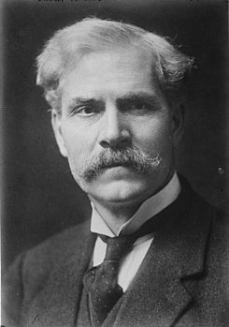
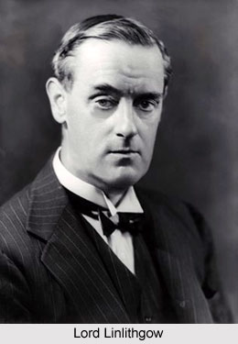
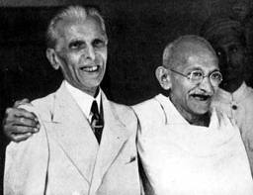
The Communal Award was by the British Prime Minister Ramsay Macdonald
on 16 August 1932
The Government of India Act 1935 passed in August 1935
Limited self-rule is achieved
Notes:
Limited self-rule is achieved

Slide 6
Krishak-Praja Party(KPP)
Nationalists failed to address welfare of poor peasants
Muslim League’s popularity declined
Demands of KPP
abolition of the zamindari system
peasants’ absolute proprietorship of land
reduction of land rent rate
giving interest free loans to peasants
creating irrigation facilities; digging canals
introduction of free primary education, etc.

Slide 7
KPP and the Bengal Legislative Assembly Elections of 1937
KPP election manifesto-‘Dal-Bhat’ for all
Opponents: Congress and Muslim League
Election result; KPP-36 (33 from Bengal), Congress- 52, and Muslim League- 39
KPP emerged as mass political party in Bengal
KPP formed coalition govt. with Muslim League

Slide 8
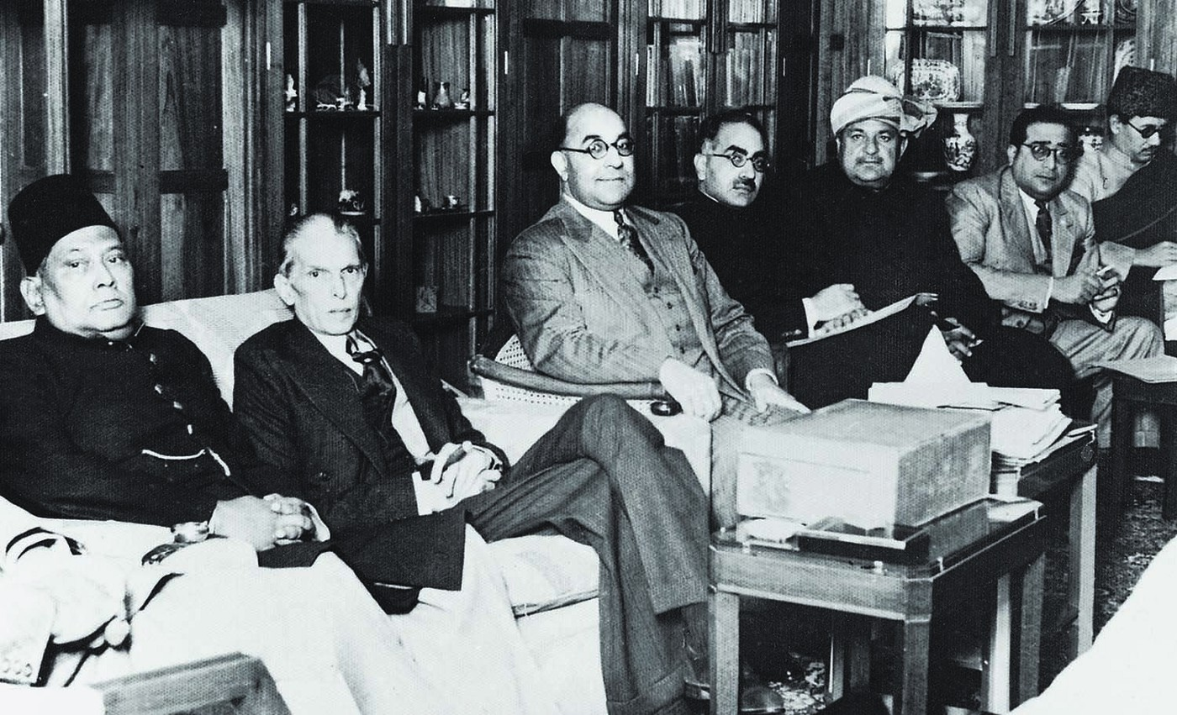
Lahore Resolution
All India Muslim League held a conference on 22-24 March 1940 in Lahore
Sir Sikandar Hayat Khan drafted Lahore Resolution that was presented by A. K. Fazlul Huq
Two Nation Theory: sovereign states for Muslims
From extreme left are Sher-e-Bengal A.K. Fazlul Huq and Mohammad Ali Jinnah. Muslim League Council Meeting in Bombay in the early 1940s. Photo: Dawn

Slide 9
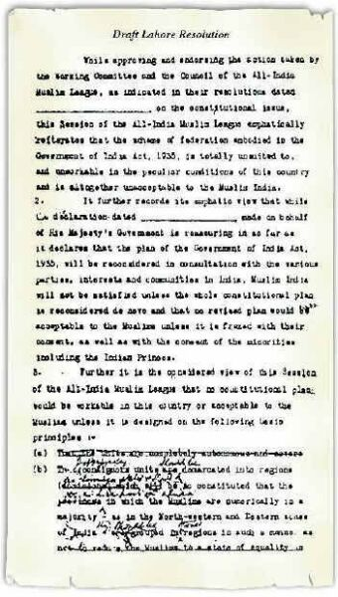
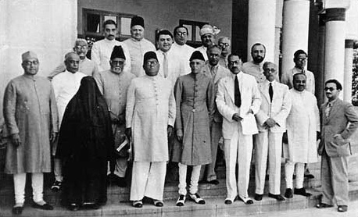
“…with such territorial readjustments as may be necessary that the areas in which the Muslims are numerically in a majority as in the North Western and Eastern Zones of (British) India should be grouped to constitute ‘independent states’ in which the constituent units should be autonomous and sovereign.”
Lahore Resolution
A line from Lahore Resolution
Draft Lahore Resolution- with proposed changes by Jinnah and Barkat Ali
Working committee of the Lahore session of All India Muslim League
Bangladesh Studies
9

Slide 10
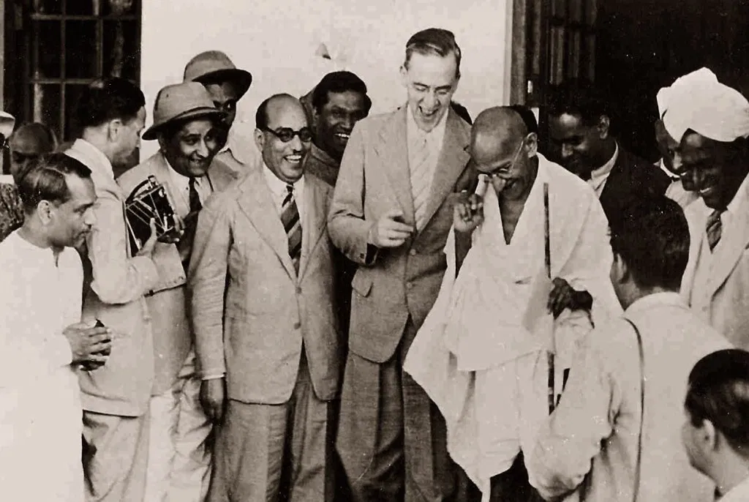
Cripps Mission & Quit India Movement
In April 1942 Sir Stafford Cripps was sent to Delhi
Offered independence of India; a constituent assembly and more seats in Viceroy’s executive council
Emphasized not to pressurize any part of the country to join independent India
Congress and British PM Churchill opposed the mission’s proposal
Failed mission led to ‘Quit India’ movement in August 1942
Sir Stafford Cripps enjoys a joke with Mr. Gandhi on his diplomatic mission in India, surrounded by Indian journalists and photographers

Slide 11
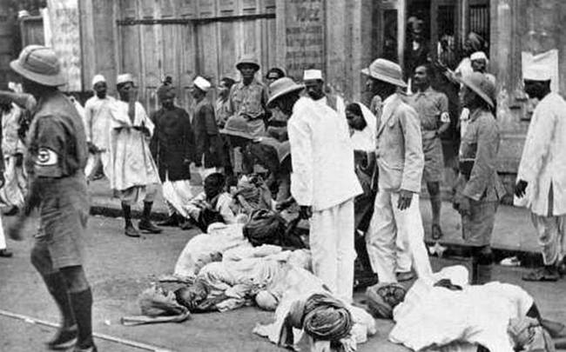
Quit India Movement
Police lathi-charge demonstrators during the Quit India movement

Slide 12
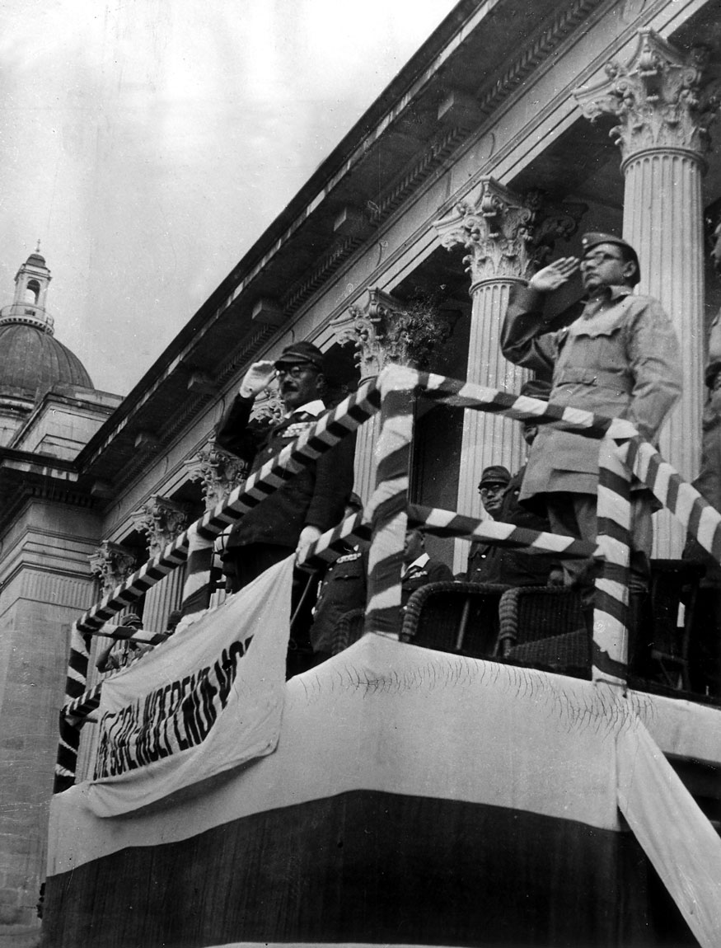
Netaji Subhas Chandra Bose & the Azad Hind Fauj
Azad Hind Fauj or Indian National Army (INA)
First formed in 17 February 1942; initiatives by Imperial Japanese Army
Subhas Chandra Bose arrived in Singapore in 1943 and revived the Army
Netaji allied with the Axis powers in WWII
INA gave hope for the freedom and self-governing rights in India
Subhas Chandra Bose with Japanese Prime Minister Hideki Tojo at a parade for Indian national independence at Singapore

Slide 13
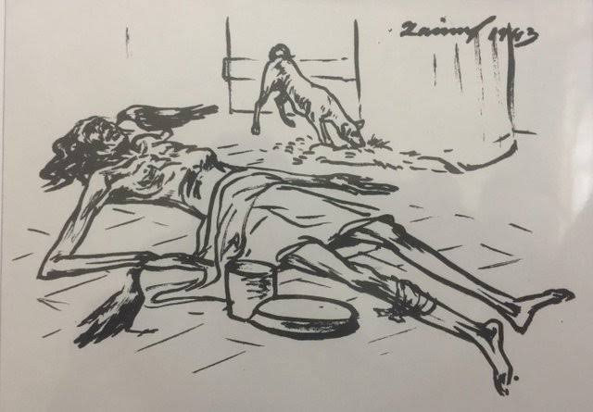
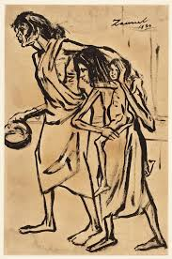
Bengal Famine of 1943
Causes of famine
Man-made famine
Natural disaster aggravated by administrative failure when rice export to Bengal from Japanese occupied Burma dried up
Rice taken for British army
Boats were confiscated by the British and inland waterways trade stopped
Market prices, widespread corruption and shortages
Sketches of the Famine of 1943 by Zainul Abedin
Bangladesh Studies
13

Slide 14
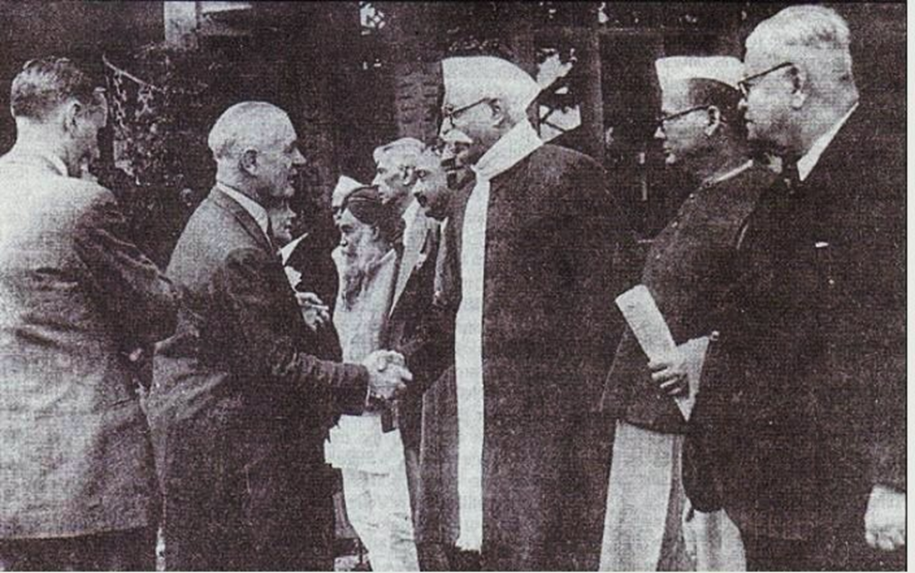
Wavell Plan and Simla Conference
Viceroy Lord Wavell called a conference at Simla on 25 June 1945
Aimed to discuss the future of India with the British administration
Lord Wavell greeting Indian leaders who have come to attend the Simla Conference in 1945

Slide 15
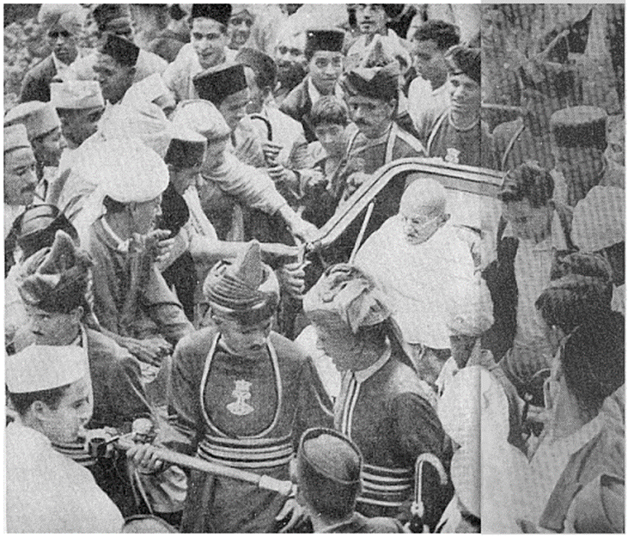
Wavell Plan and Simla Conference
Proposals
An all-Indian executive council to form interim government
It restricted viceroy and commander-in-chief positions from Indians
It preserved seats for ‘Caste Hindus’ and Muslims
Differences on the representation of Muslim community
The Muslim League itself as only Muslim representative
Congress presented the leader of their delegation leader to prove their all communities’ representation
Mahatma Gandhi in Shimla to attend the Simla Conference in 1945 called by the Viceroy, Lord Wavell

Slide 16
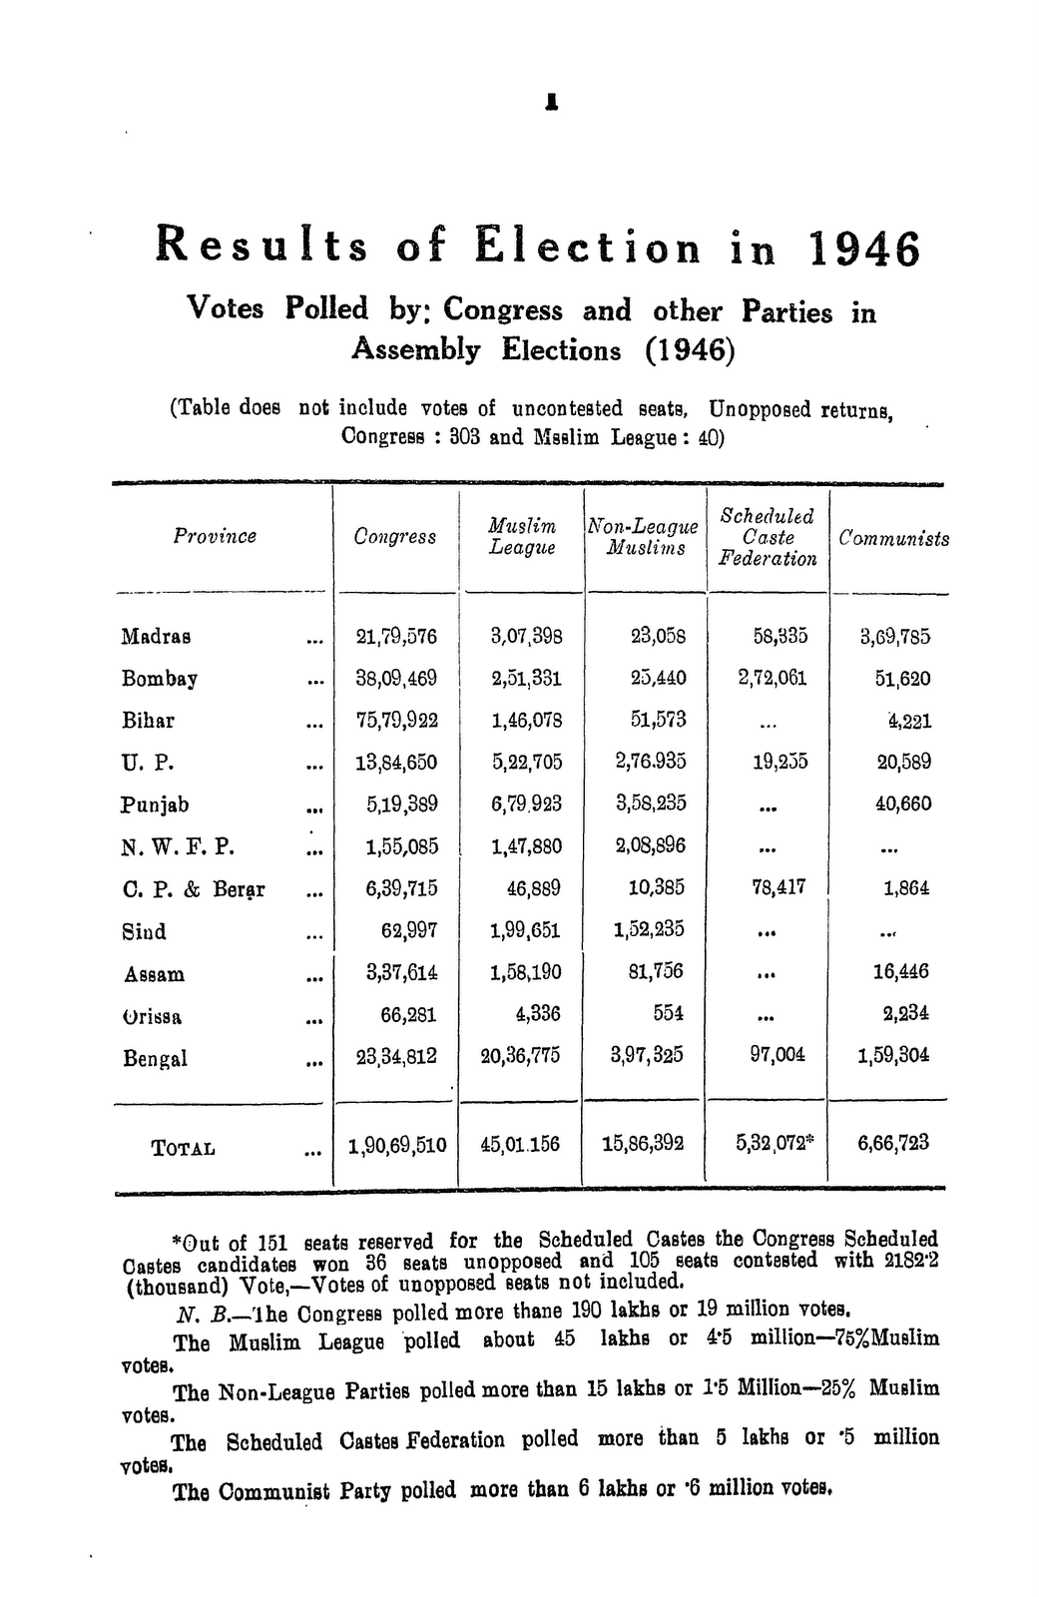
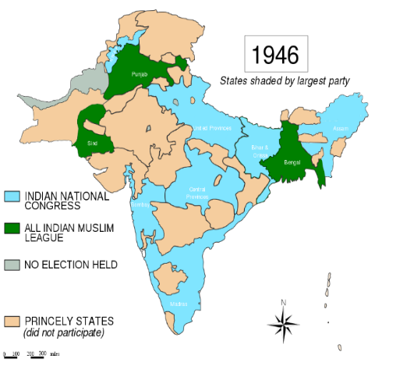
Elections of 1945-46

Slide 17
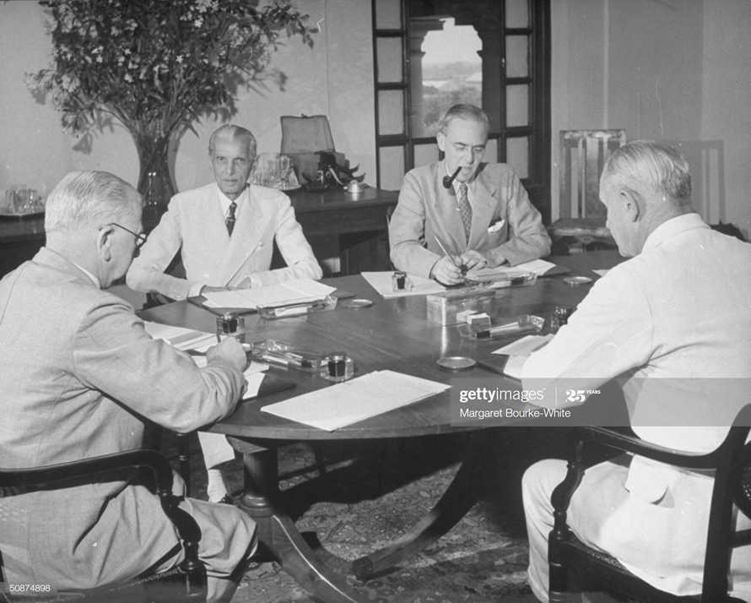
Cabinet Mission, 1946
Three-man cabinet deputation to New Delhi
Transfer of British power to a single Indian administration
Proposed a three-tier federation for India
Local provincial governments can opt out
Primarily both ML and Congress agreed
Nehru- no Constituent Assembly could be “bound” by any prearranged constitutional formula
Muslim League withdrew its support
British Cabinet commission members A. V. Alexander (L) Frederick William Pethick-Lawrence (R) & Sir Stafford Cripps (2R) discussing plan for India's Independence w. Moslem League ldr. Mohammed Ali Jinnah (2L) during meetings at the vice-regal lodge

Slide 18
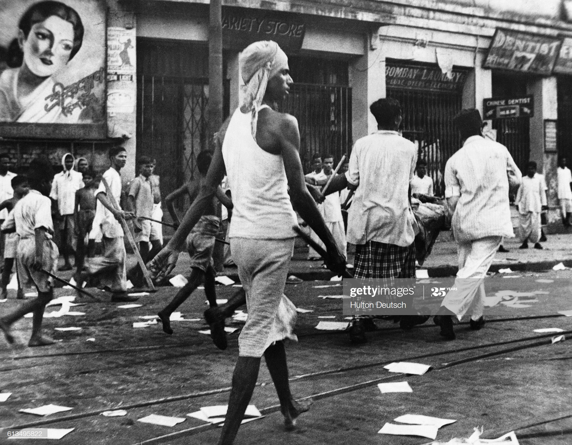
Direct Action Day and the Great Calcutta Killings
Muslim League announced a general strike on 16 August 1946
Widespread communal rioting between Muslims and Hindus
An estimated 4,000 people lost their lives
These events sowed the seeds for the eventual Partition
Rioters armed with lathis on the streets
of Calcutta in 1946

Slide 19
Proposal of United Bengal
Huseyn Shaheed Suhrawardy, the Premier of the province of Bengal, formally launched this idea
Sarat Chandra Bose proposed for a Sovereign Socialist Republic of Bengal
Most provincial Congress and Hindu Mahasabha leaders wanted Bengal partition
The Direct Action Day aggravated communal tension

Slide 20
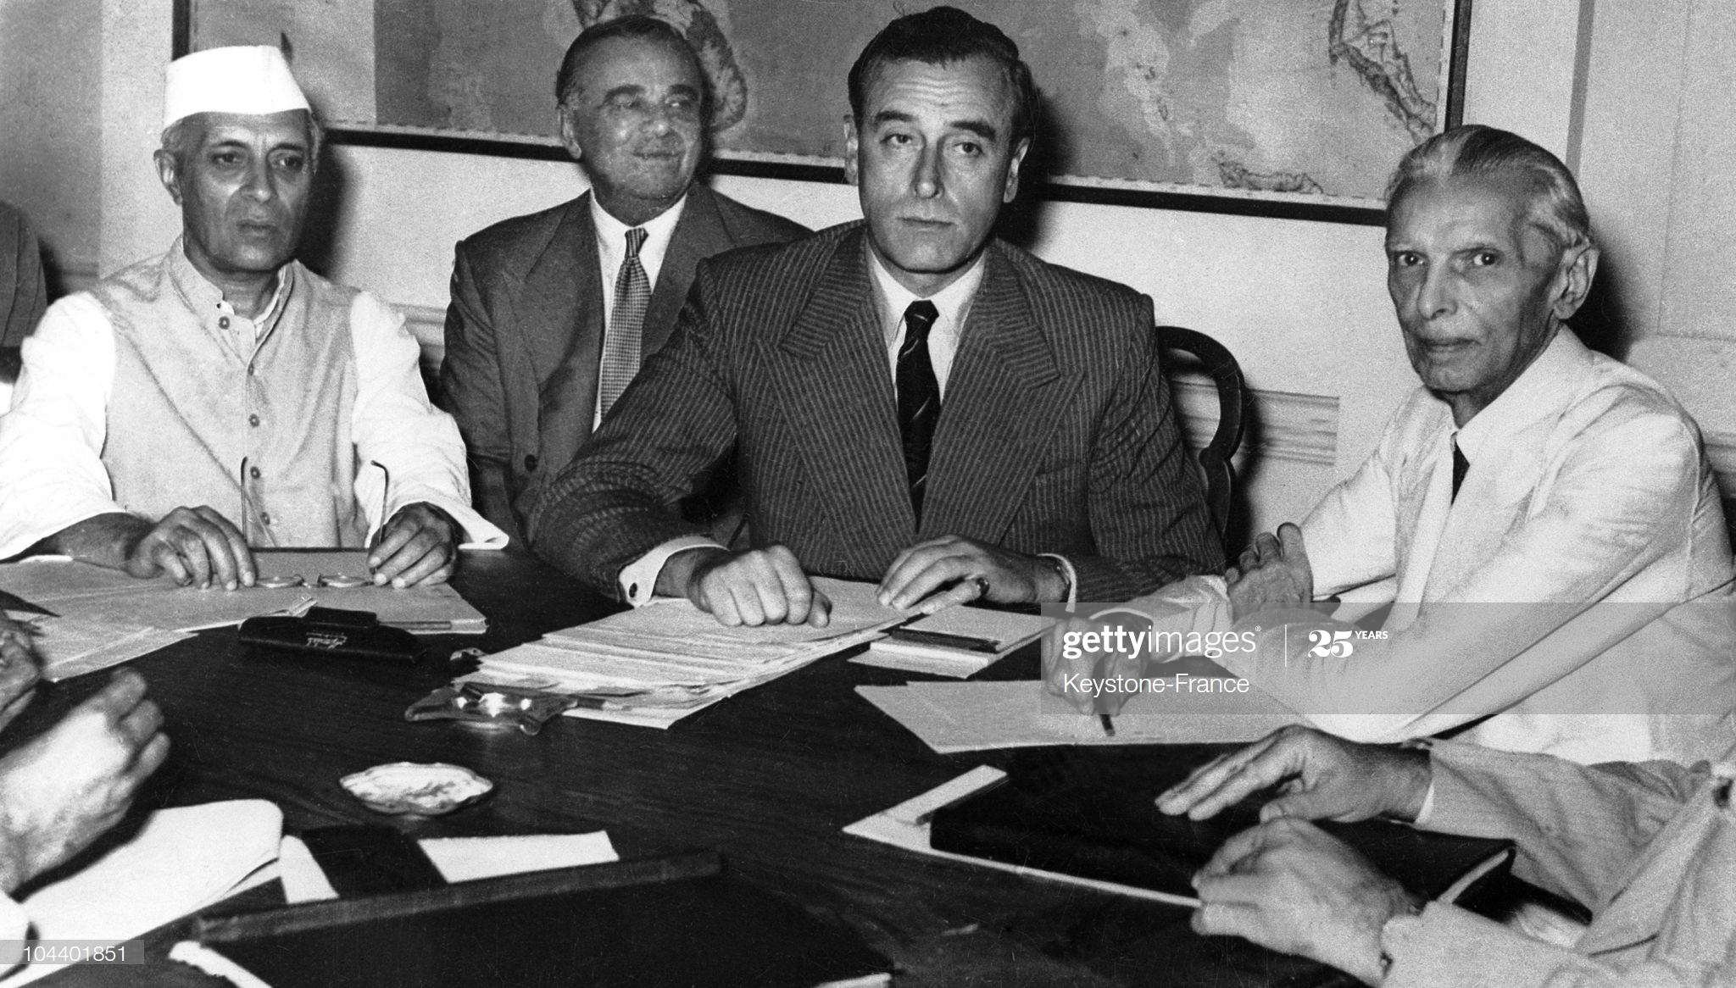
Partition Plan & the Radcliffe Boundary Commission
Boundary Commission created in July 1947
The commission was appointed by the British Government
Chaired by Sir Cyril Radcliffe
To recommend how the divide Bengal and Punjab between India and Pakistan
Sparked mass migrations
When there was a country I searched for freedom. Now I am free, but have to search for a country
During an historic conference in New Delhi, Lord Mountbatten and the main Indian leaders agree upon the partition of India according to a British plan. At the conference, from left to right: Pandit Jawaharlal Nehru, Lord Ismay, councilor to Lord Mountbatten and India's viceroy; and M. A. Jinnah.

Slide 21
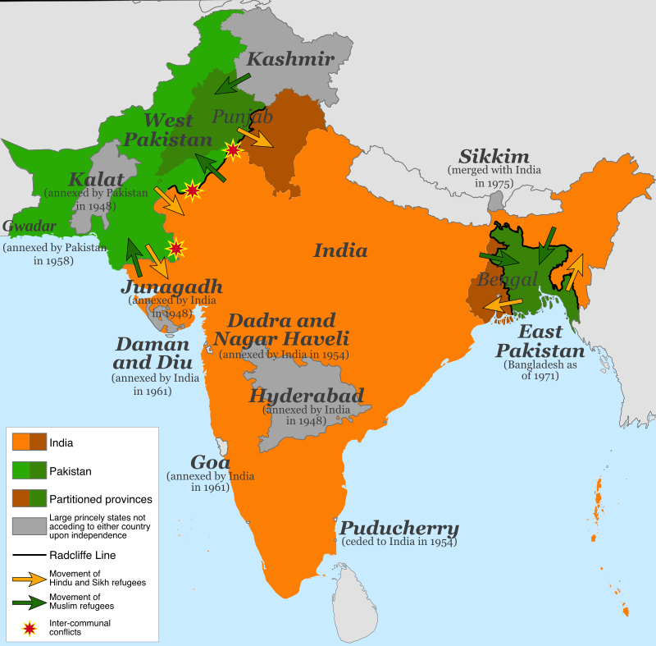
Partition Plan & of Radcliffe Line

Slide 22
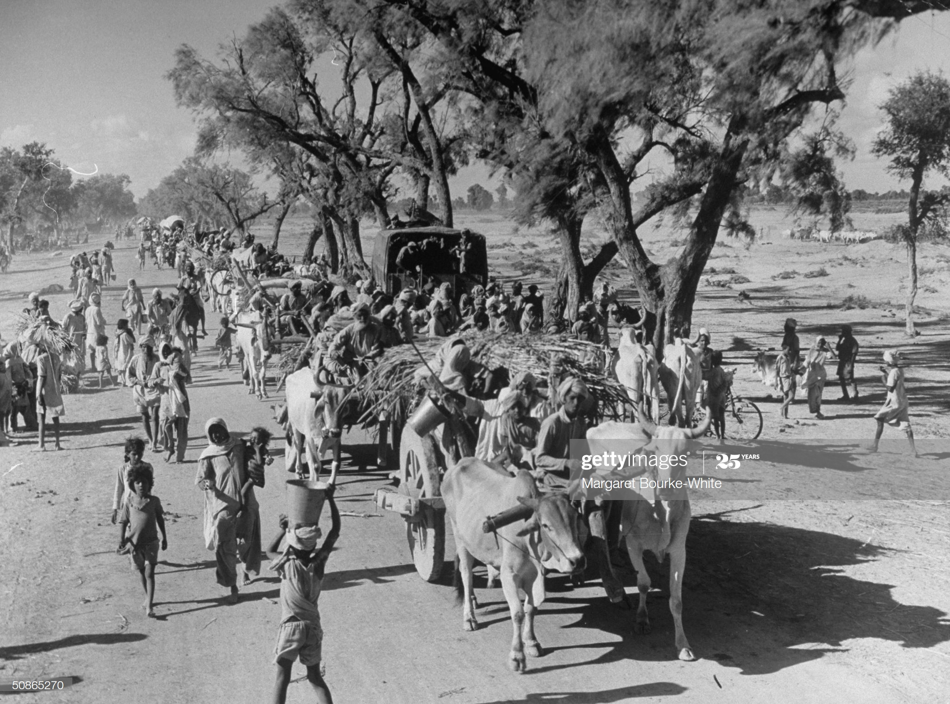
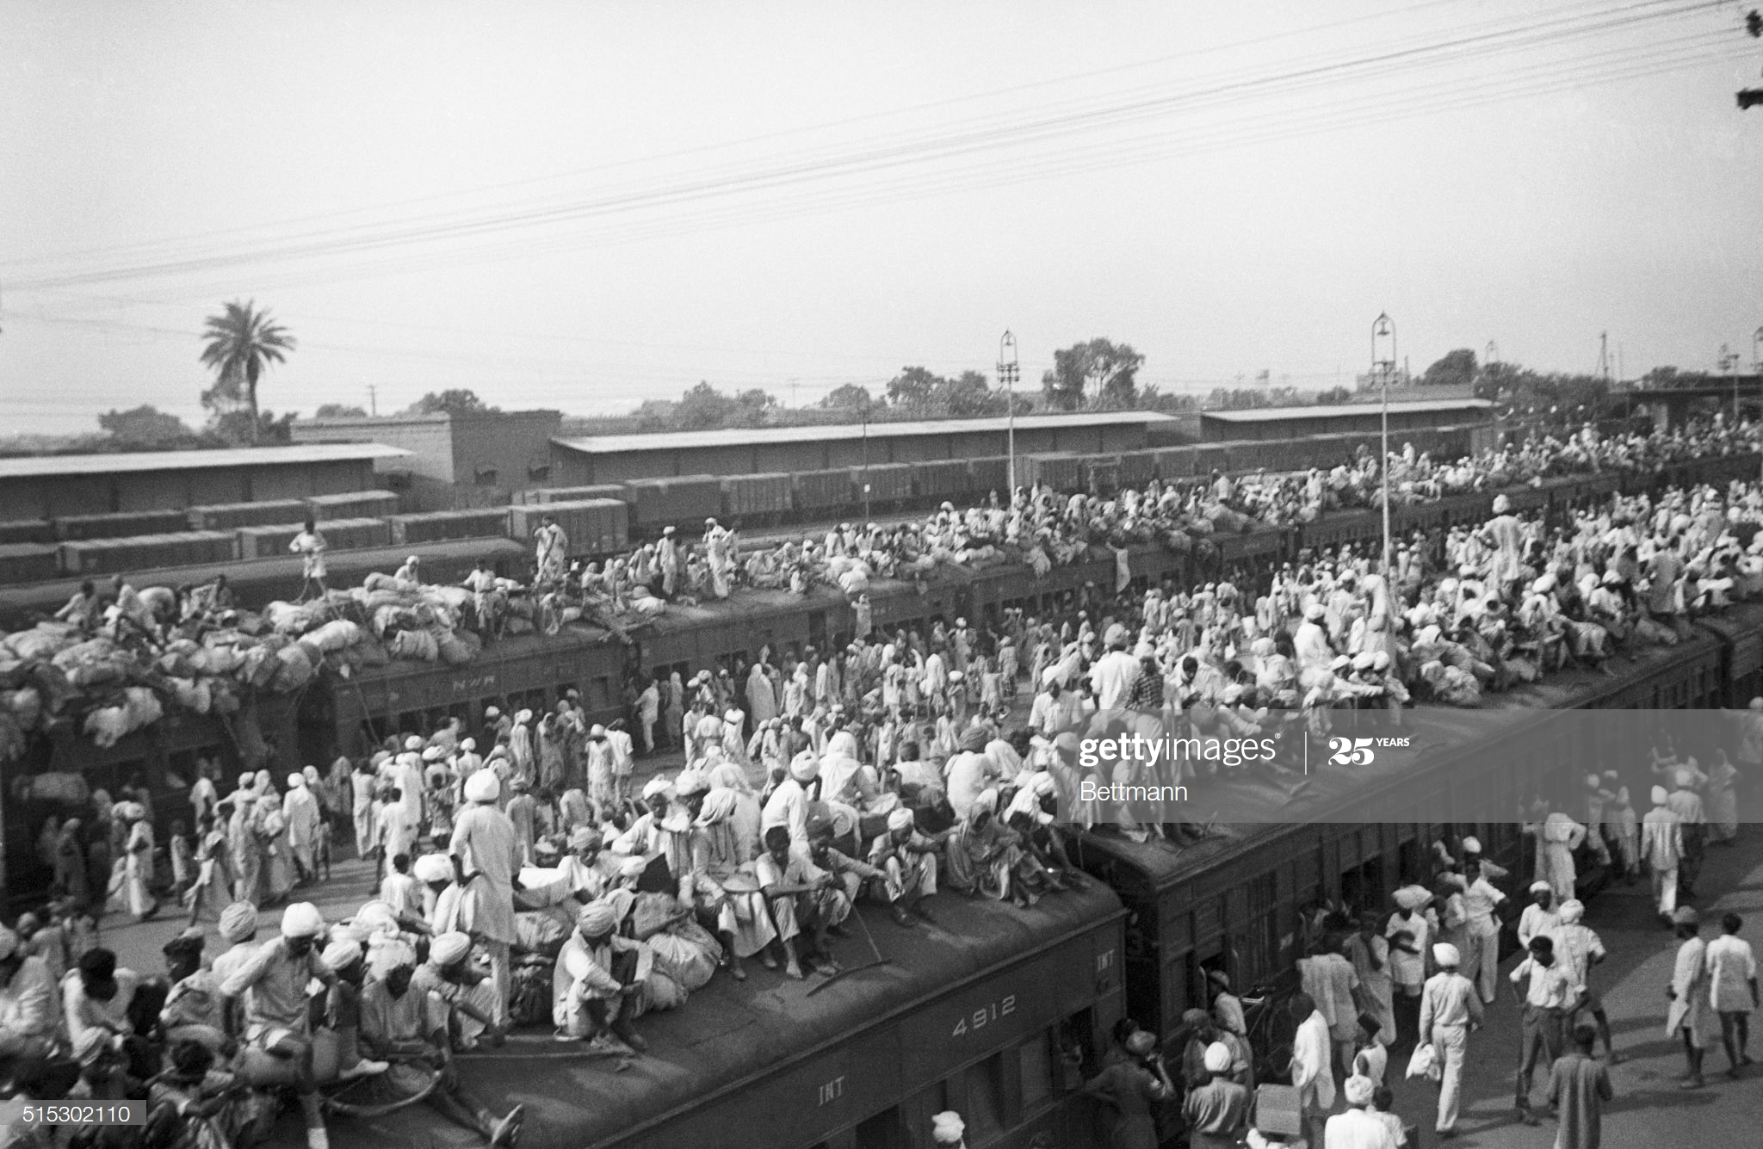
Refugee Crisis
Indian refugees crowd onto to trains as a result of the creation of two independent states, India and Pakistan. Muslims fled to Pakistan and Hindus fled to India in one of the largest transfers of population in history.
Convoy of Sikhs migrating to East Punjab after the division of India

Slide 23
References
Bose, Sugata & Jalal, Ayesha, Modern South Asia: History, Culture, Political Economy (New York and London: Routledge, 2004).
Bandyopadhyay, Sekhar, From Plassey to Partition: A History of Modern India (New Delhi: Orient Longman, 2004)
Hasan, Tariq, Colonialism and the Call to Jihad in British India (New Delhi: Sage, 2015)
Metcalf, Barbara D. &amp; Metcalf, Thomas R., A Concise History of Modern India (Cambridge:Cambridge University Press, 2006).
Sarkar, Sumit, Modern India: 1885-1947 (New Delhi: Pearson, 2014) and Chapter 7, pp. 321- 353 & Chapter 8, pp. 355-389.
Schendel, Willem Van, A History of Bangladesh (Cambridge: Cambridge University Press, 2009), (Chapters 09 & 10).
Butalia, Urvashi, The Other Side of Silence: Voices from the Partition of India (New Delhi: Penguin Books, 1998).

